Slide 1
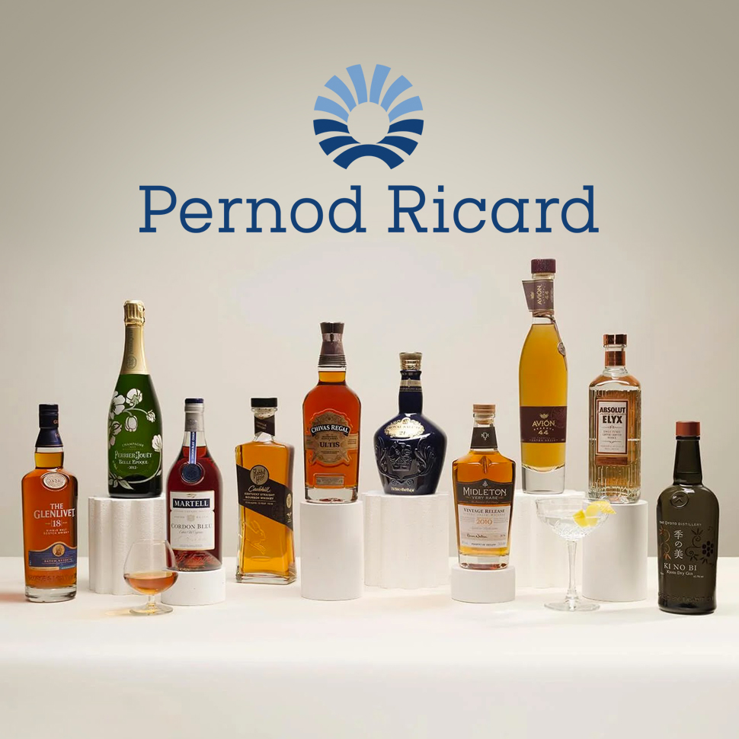
IOWA CAPSTONE: Pernod Ricard
Jessica Navarro

Slide 2
SCENERIO
I looked at the Pernod Ricard sales database to see how our alcohol products are performing. I focused on what’s doing well, what needs improvement, and where there’s room to grow. This takes into consideration population, competitors, and which products are our best performers or “hero product”.

Slide 3
SUMMARY STATS FOR DB
TOTAL REVENUE : $28,157,424.53
TOTAL STORES: 1,321
AVERAGE
PRICE: $18.08
TOTAL TRANSACTIONS: 192,592
PRODUCT AMOUNT: 599
DESCRIPTION

Slide 4
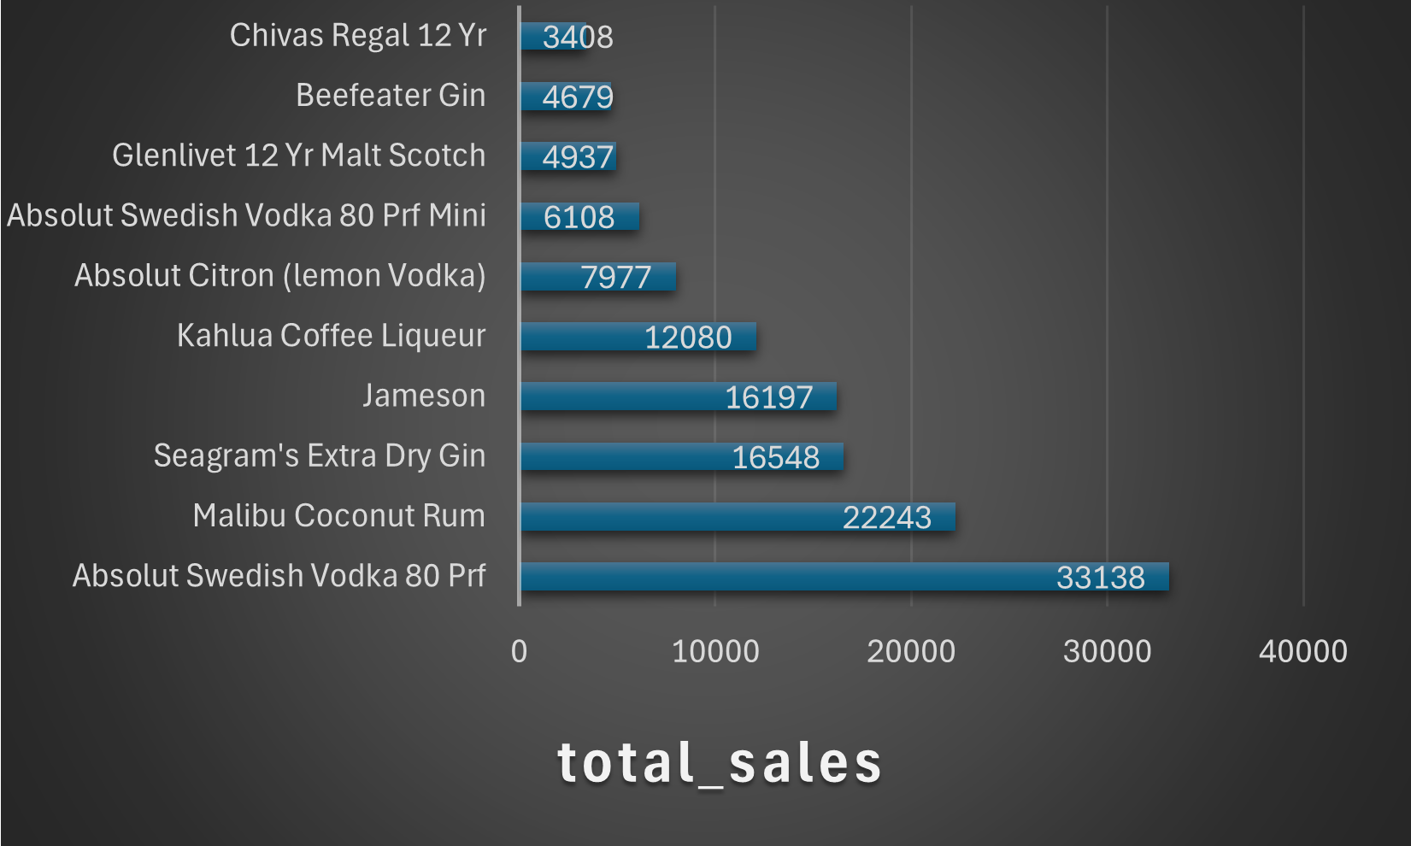
ANALYSIS 1 STRENGTHS
Highlights top 10 and most popular product

Slide 5
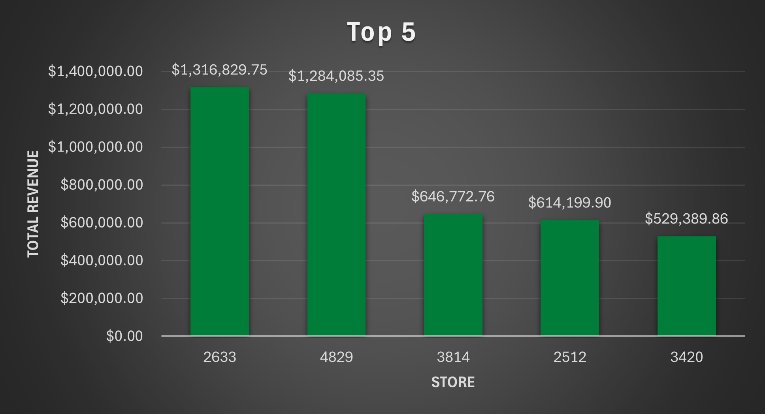
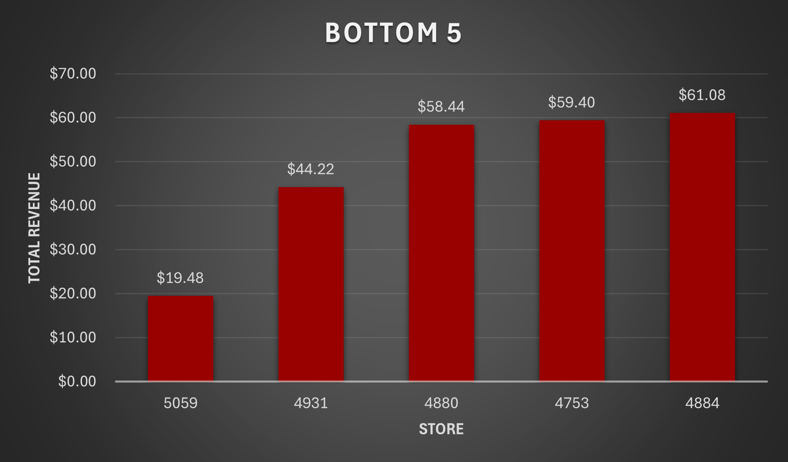
ANALYSIS 2 WEAKNESSES
Worst performing store

Slide 6
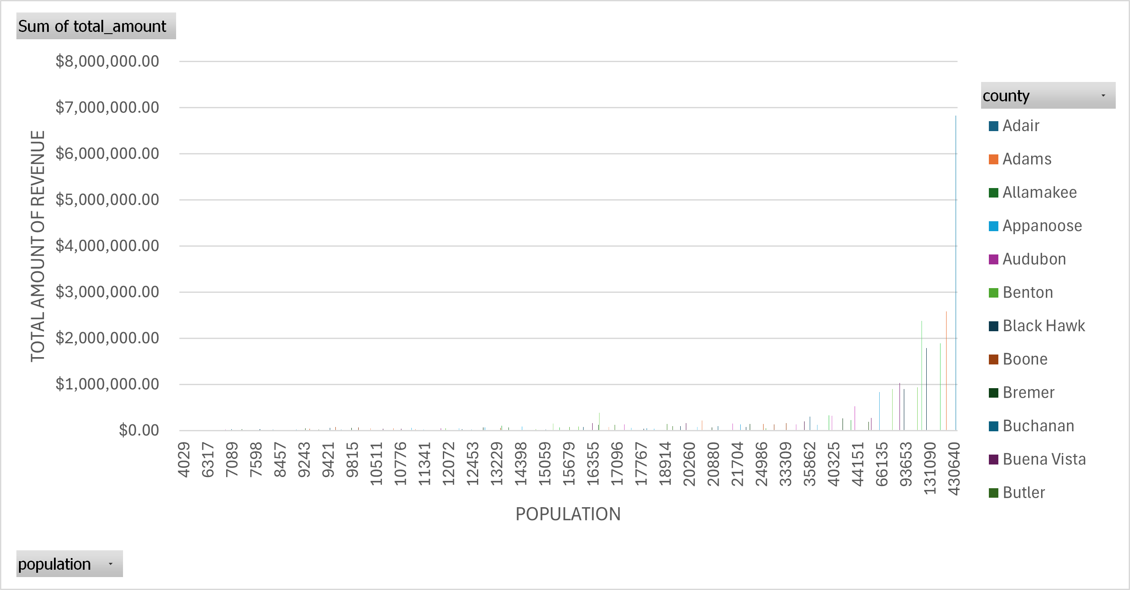
ANALYSIS 3 OPPORTUNITIES
population vs sales SHOWS GROWTH POTENTIAL

Slide 7
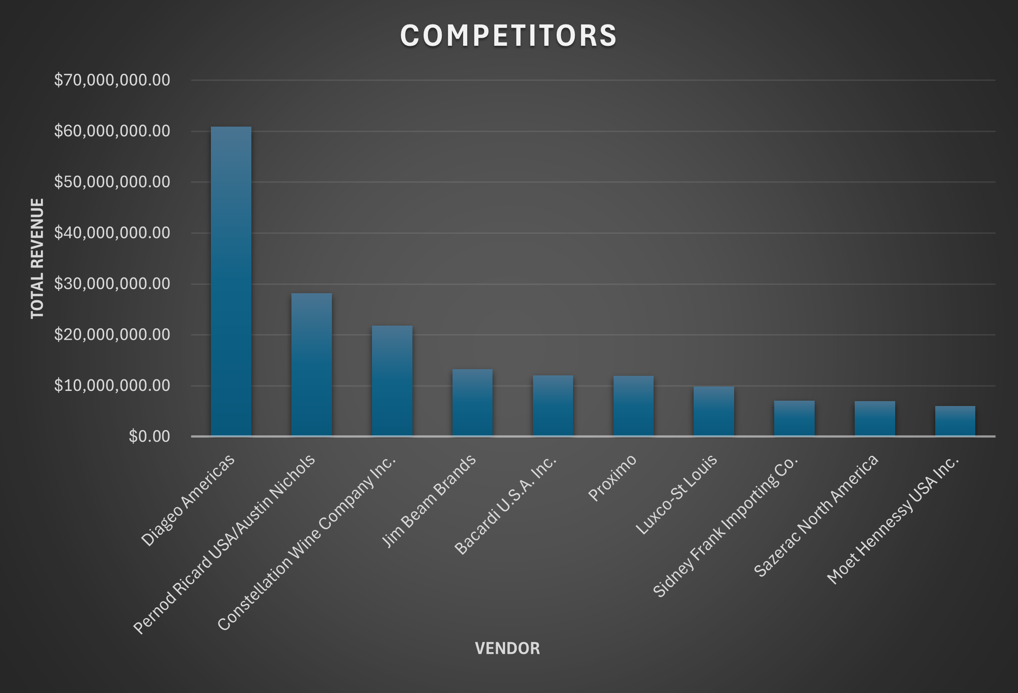
ANALYSIS 4 THREATS
Who is out performing me?

Slide 8
SUMMARY/RECOMMENDATIONS
Focus more on the products and stores that are already doing well to increase sales
Expand into areas with higher populations to reach more customers
Work on improving low-performing stores while staying competitive with other vendors

